Slide 1


Using Predictions in Online Optimization: Looking Forward with an Eye on the Past
Niangjun Chen
Joint work with Joshua Comden, Zhenhua Liu, Anshul Gandhi, and Adam Wierman

Slide 2

Predictions are crucial for decision making
Notes:
Travel, finance, cloud management …

Slide 3

Predictions are crucial for decision making
“The human brain, it is being increasingly argued in the
scientific literature, is best viewed as an advanced prediction
machine.”
Notes:
Travel, finance, cloud management …

Slide 4
We know how to make predictions

Slide 5
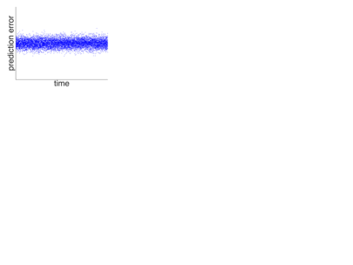
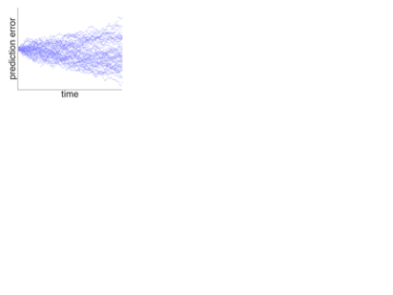
We know how to make predictions
But not how to design algorithms to use prediction
independent
How should an algorithm
use predictions if errors are
vs
correlated

Slide 6
This paper: Online algorithm design with predictions in mind

Slide 7

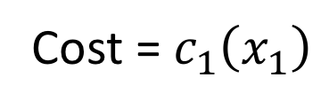
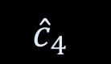
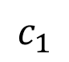
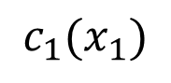
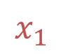

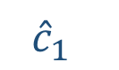
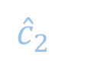
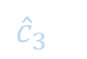
$${\hat{c}}_{1}$$
$${\hat{c}}_{3}$$
$${\hat{c}}_{2}$$
$$c_{1}$$
$${\hat{c}}_{4}$$
Prediction error
$$c_{1}(x_{1})$$
$$x_{1}$$
$$F$$
Cost = $c_{1}\left(x_{1}\right)$

Slide 8
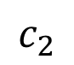
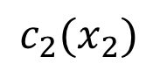
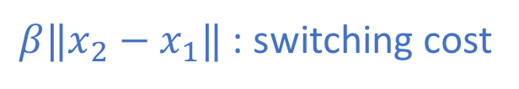
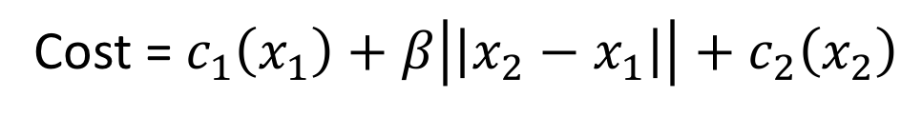
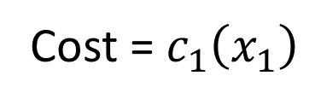


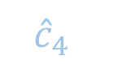
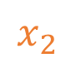
$${\hat{c}}_{3}$$
$${\hat{c}}_{2}$$
$${\hat{c}}_{4}$$
$$c_{2}$$
Prediction error
$$c_{2}(x_{2})$$
$$x_{1}$$
$$x_{2}$$
$$F$$
$β‖x_{2}−x_{1}‖$ : switching cost
Cost = $c_{1}\left(x_{1}\right)+β\left|\left|x_{2}−x_{1}\right|\right|+c_{2}\left(x_{2}\right)$
Cost = $c_{1}\left(x_{1}\right)$

Slide 9
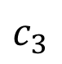
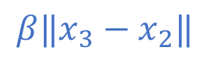
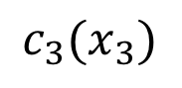



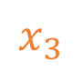
$${\hat{c}}_{3}$$
$${\hat{c}}_{4}$$
$$c_{3}$$
Prediction error
$$c_{3}(x_{3})$$
$$x_{1}$$
$$x_{3}$$
$$x_{2}$$
$$F$$
$$β‖x_{3}−x_{2}‖$$
Cost = $c_{1}\left(x_{1}\right)+β\left|\left|x_{2}−x_{1}\right|\right|+c_{2}\left(x_{2}\right)+β\left|\left|x_{3}−x_{2}\right|\right|+c_{3}\left(x_{3}\right)…$
Cost = $c_{1}\left(x_{1}\right)+β\left|\left|x_{2}−x_{1}\right|\right|+c_{2}\left(x_{2}\right)$

Slide 10
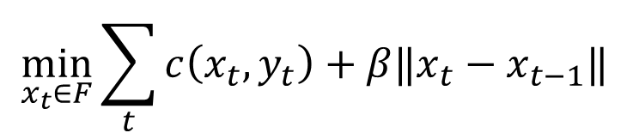
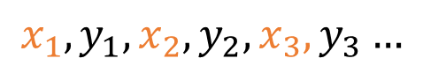

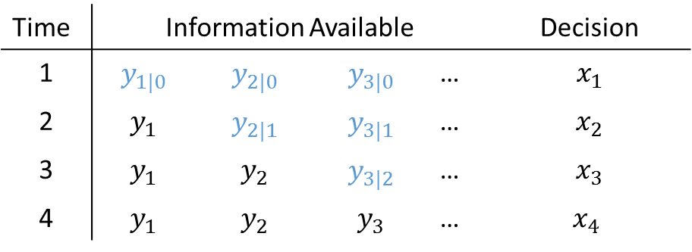
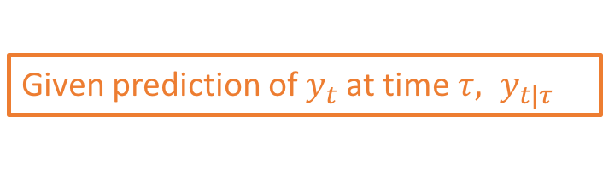
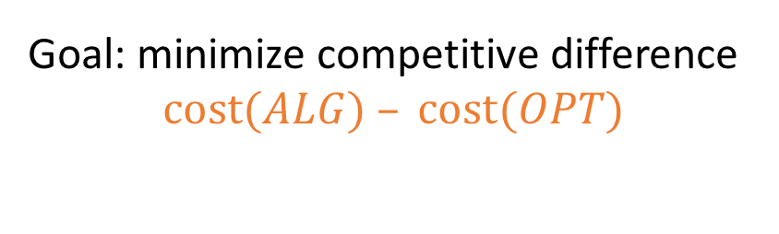
Online convex optimization using predictions
$$x_{1},y_{1},x_{2},y_{2},x_{3},y_{3}…$$
online
Goal: minimize competitive difference
$cost(ALG) – cost(OPT)$
$$\min_{x_{t}∈F}{\sum_{t}{c\left(x_{t}, y_{t}\right)}+β‖x_{t}−x_{t−1}‖ }$$
convex
switching cost
e.g. online tracking cost
$$c\left(x_{t},y_{t}\right)$$
Given prediction of $y_{t}$at time $τ, y_{t|τ}$
Time | Information Available |  |  |  | Decision
1 | $$y_{1|0}$$ | $$y_{2|0}$$ | $$y_{3|0}$$ | … | $$x_{1}$$
2 | $$y_{1}$$ | $$y_{2|1}$$ | $$y_{3|1}$$ | … | $$x_{2}$$
3 | $$y_{1}$$ | $$y_{2}$$ | $$y_{3|2}$$ | … | $$x_{3}$$
4 | $$y_{1}$$ | $$y_{2}$$ | $$y_{3}$$ | … | $x_{4}$
Notes:
Parameterized family

Slide 11
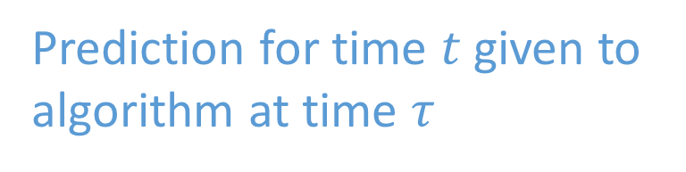
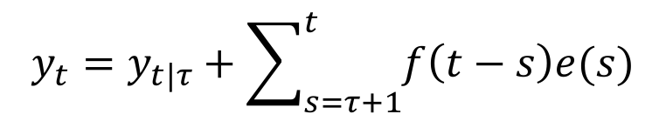
Prediction noise model
[Gan et al 2013] [Chen et al 2014] [Chen et al 2015]
$$y_{t}=y_{t|τ}+\sum_{s=τ+1}^{t}{f\left(t−s\right)e(s)}$$
Realization that algorithm is trying to track
prediction error
Prediction for time $t$ given to
algorithm at time $τ$

Slide 12
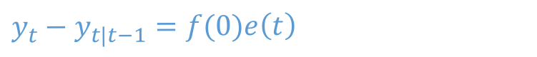
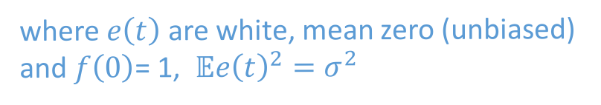
Prediction noise model
[Gan et al 2013] [Chen et al 2014] [Chen et al 2015]
Per-step noise
$$y_{t}=y_{t|τ}+\sum_{s=τ+1}^{t}{f\left(t−s\right)e(s)}$$
How much uncertainty is there one step ahead?
$$y_{t}−y_{t|t−1}=f(0)e\left(t\right)$$
where $e\left(t\right)$ are white, mean zero (unbiased)
and $f\left(0\right)$= 1, $𝔼e{\left(t\right)}^{2}=σ^{2}$

Slide 13
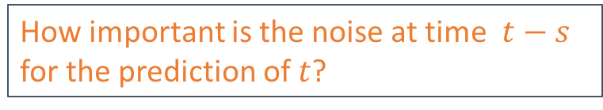
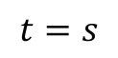
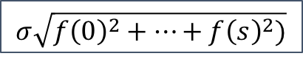
Prediction noise model
[Gan et al 2013] [Chen et al 2014] [Chen et al 2015]
Weighting factor
$$y_{t}=y_{t|τ}+\sum_{s=τ+1}^{t}{f\left(t−s\right)e(s)}$$
How important is the noise at time $t−s$ for the prediction of $t$?
$$σ\sqrt{f{\left(0\right)}^{2}+…+f{\left(s\right)}^{2})}$$
$$t=s$$

Slide 14
Prediction noise model
[Gan et al 2013] [Chen et al 2014] [Chen et al 2015]
$$y_{t}=y_{t|τ}+\sum_{s=τ+1}^{t}{f\left(t−s\right)e(s)}$$
prediction error
Predictions are “refined” as time moves forward
Predictions are more noisy as you look further ahead
Prediction errors can be correlated
Form of errors matches many classical models
Prediction of wide-sense stationary process using Wiener filter
Prediction of linear dynamical system using Kalman filter

Slide 15
Lots of applications …
Dynamic capacity management in data centers [Gandhi et al. 2012][Lin et al 2013]
Power system generation/load scheduling[Lu et al. 2013]
Portfolio management [Cover 1991][Boyd et al. 2012]
Video streaming [Sen et al. 2000][Liu et al. 2008]
Network routing [Bansal et al. 2003][Kodialam et al. 2003]
Geographical load balancing [Hindman et al. 2011] [Lin et al. 2012]
Visual speech generation [Kim et al. 2015]
…
Notes:
A lot of online decision problem can be modeled as an OCO, for example, capacity management of data centers -> number of servers or virtual resource, -> adjust encoding bitrate to network condition, many Sigmetrics papers!

Slide 16

Lots of applications …
Dynamic capacity management in data centers [Gandhi et al. 2012][Lin et al 2013]
Power system generation/load scheduling[Lu et al. 2013]
Portfolio management [Cover 1991][Boyd et al. 2012]
Video streaming [Sen et al. 2000][Liu et al. 2008]
Network routing [Bansal et al. 2003][Kodialam et al. 2003]
Geographical load balancing [Hindman et al. 2011] [Lin et al. 2012]
Visual speech generation [Kim et al. 2015]
…
Notes:
A lot of online decision problem can be modeled as an OCO, for example, capacity management of data centers -> number of servers or virtual resource, -> adjust encoding bitrate to network condition, many Sigmetrics papers!

Slide 17
Lots of applications …
Dynamic capacity management in data centers [Gandhi et al. 2012][Lin et al 2013]
Power system generation/load scheduling[Lu et al. 2013]
Portfolio management [Cover 1991][Boyd et al. 2012]
Video streaming [Sen et al. 2000][Liu et al. 2008]
Network routing [Bansal et al. 2003][Kodialam et al. 2003]
Geographical load balancing [Hindman et al. 2011] [Lin et al. 2012]
Visual speech generation [Kim et al. 2015]
…
Notes:
A lot of online decision problem can be modeled as an OCO, for example, capacity management of data centers -> number of servers or virtual resource, -> adjust encoding bitrate to network condition, many Sigmetrics papers!

Slide 18
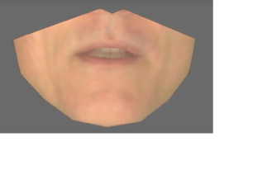
Lots of applications …
Dynamic capacity management in data centers [Gandhi et al. 2012][Lin et al 2013]
Power system generation/load scheduling[Lu et al. 2013]
Portfolio management [Cover 1991][Boyd et al. 2012]
Video streaming [Sen et al. 2000][Liu et al. 2008]
Network routing [Bansal et al. 2003][Kodialam et al. 2003]
Geographical load balancing [Hindman et al. 2011] [Lin et al. 2012]
Visual speech generation [Kim et al. 2015]
…
Notes:
A lot of online decision problem can be modeled as an OCO, for example, capacity management of data centers -> number of servers or virtual resource, -> adjust encoding bitrate to network condition, many Sigmetrics papers!

Slide 19
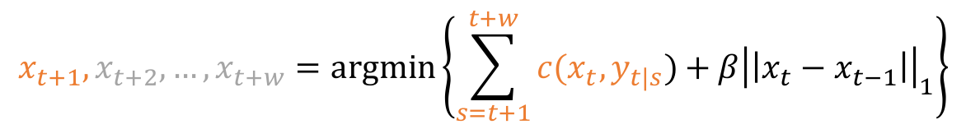
Lots of applications… lots of algorithms
Most popular choice by far: Receding Horizon Control (RHC)
[Morari et al 1989][Mayne 1990][Rawling et al 2000][Camacho 2013]…
$$y_{t+1|t},y_{t+2|t},…,y_{t+w|t},y_{t+w+1|t},y_{t+w+2|t},…$$
$$x_{t+1},x_{t+2},…,x_{t+w}=argmin\left\{\sum_{s=t+1}^{t+w}{c(x_{t},y_{t|s})+β{\left|\left|x_{t}−x_{t−1}\right|\right|}_{1}}\right\}$$

Slide 20
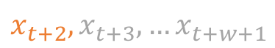
Lots of applications… lots of algorithms
Most popular choice by far: Receding Horizon Control (RHC)
[Morari et al 1989][Mayne 1990][Rawling et al 2000][Camacho 2013]…
$$y_{t+1|t},y_{t+2|t},…,y_{t+w|t},y_{t+w+1|t},y_{t+w+2|t},…$$
$$y_{t+2|t+1},y_{t+3|t+1},…,y_{t+w+1|t+1},y_{t+w+2|t+1},y_{t+w+3|t+1},…$$
$$x_{t+2}, x_{t+3}, …x_{t+w+1}$$

Slide 21
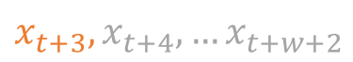
Lots of applications… lots of algorithms
Most popular choice by far: Receding Horizon Control (RHC)
[Morari et al 1989][Mayne 1990][Rawling et al 2000][Camacho 2013]…
$$y_{t+1|t},y_{t+2|t},…,y_{t+w|t},y_{t+w+1|t},y_{t+w+2|t},…$$
$$y_{t+2|t+1},y_{t+3|t+1},…,y_{t+w+1|t+1},y_{t+w+2|t+1},y_{t+w+3|t+1},…$$
$$y_{t+3|t+2},y_{t+4|t+2},…,y_{t+w+2|t+2},y_{t+w+3|t+2},y_{t+w+4|t+2},…$$
$$x_{t+3}, x_{t+4}, …x_{t+w+2}$$

Slide 22
Lots of applications… lots of algorithms
Most popular choice by far: Receding Horizon Control (RHC)
[Morari et al 1989][Mayne 1990][Rawling et al 2000][Camacho 2013]…
Recent suggestion: Averaging Fixed Horizon Control (AFHC)
[Lin et al 2012] [Chen et al 2015] [Kim et al 2015]

Slide 23
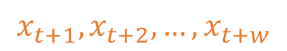
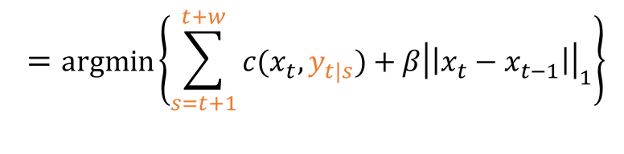
Averaging Fixed Horizon Control
Fixed Horizon Control (FHC)
$$y_{t+1|t},y_{t+2|t},…,y_{t+w|t},y_{t+w+1|t+w},y_{t+w+2|t+w},…$$
$$=argmin\left\{\sum_{s=t+1}^{t+w}{c(x_{t},y_{t|s})+β{\left|\left|x_{t}−x_{t−1}\right|\right|}_{1}}\right\}$$
$$x_{t+1},x_{t+2},…,x_{t+w}$$

Slide 24

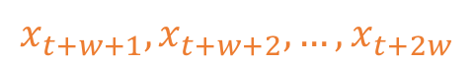
Averaging Fixed Horizon Control
Fixed Horizon Control (FHC)
$$y_{t+1|t},y_{t+2|t},…,y_{t+w|t},y_{t+w+1|t+w},y_{t+w+2|t+w},…$$
$$x_{t+1},x_{t+2},…,x_{t+w}$$
$$x_{t+w+1},x_{t+w+2},…,x_{t+2w}$$

Slide 25
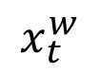
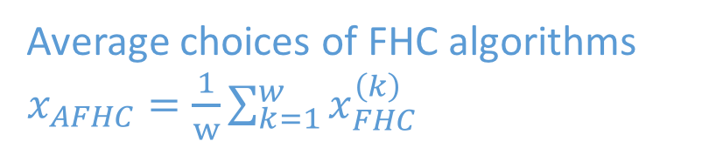

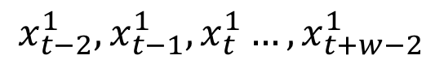
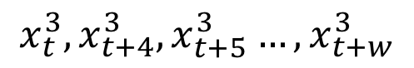
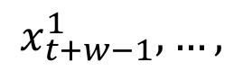
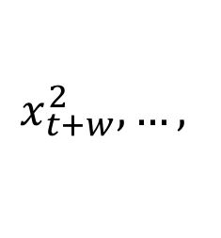
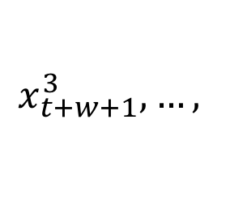
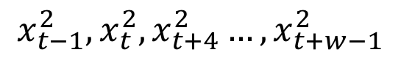
Averaging Fixed Horizon Control
Average choices of FHC algorithms $x_{AFHC}=\frac{1}{w}\sum_{k=1}^{w}{x_{FHC}^{\left(k\right)}}$
$$x_{t−2}^{1},x_{t−1}^{1},x_{t}^{1}…,x_{t+w−2}^{1}$$
$$x_{t+w−1}^{1},…,$$
$$x_{t−1}^{2},x_{t}^{2},x_{t+4}^{2}…,x_{t+w−1}^{2}$$
$$x_{t+w}^{2},…,$$
$w$ FHC algorithms
$$x_{t}^{3},x_{t+4}^{3},x_{t+5}^{3}…,x_{t+w}^{3}$$
$$x_{t+w+1}^{3},…,$$
…
$$x_{t}^{w}$$

Slide 26
Algorithms Using Noisy Prediction
Most popular choice by far: Receding Horizon Control (RHC)
[Morari et al 1989][Mayne 1990][Rawling et al 2000][Camacho 2013]…
Recent suggestion: Averaging Fixed Horizon Control (AFHC)
[Lin et al 2012] [Chen et al 2015] [Kim et al 2015]
Which algorithm is better?
Unclear…

Slide 27
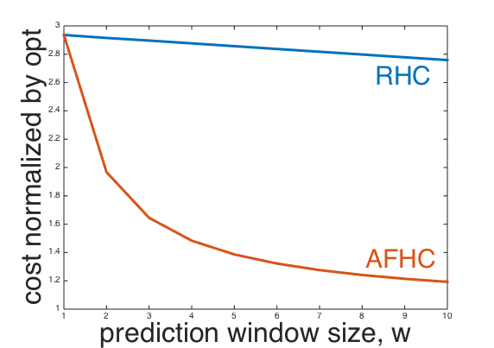
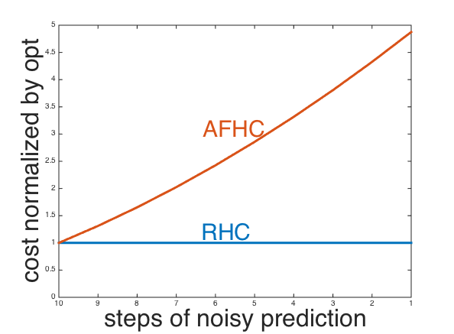
AFHC and RHC have vastly different behavior
AFHC is better in worst case under perfect predictions
Empirically
RHC is better in stochastic case when prediction errors are correlated

Slide 28
This paper: Online algorithm design with predictions in mind
How to design algorithm optimal for prediction noise?

Slide 29

Three key design choices
1. How far to look-ahead in making decisions?
$$y_{t+1|t},y_{t+2|t},…,y_{t+w|t},y_{t+w+1|t},y_{t+w+2|t},…$$
Lookahead $w$ steps

Slide 30

Three key design choices
1. How far to look-ahead in making decisions?
2. How many actions to commit?
$$y_{t+1|t},y_{t+2|t},…,y_{t+w|t},y_{t+w+1|t},y_{t+w+2|t},…$$
$$x_{t+1},x_{t+2},…,x_{t+w}=argmin\left\{\sum_{s=t+1}^{t+w}{c(x_{t},y_{t|s})+β{\left|\left|x_{t}−x_{t−1}\right|\right|}_{1}}\right\}$$

Slide 31


Three key design choices
1. How far to look-ahead in making decisions?
2. How many actions to commit?
$$y_{t+1|t},y_{t+2|t},…,y_{t+w|t},y_{t+w+1|t},y_{t+w+2|t},…$$
$$x_{t+1},x_{t+2},…,x_{t+w}=argmin\left\{\sum_{s=t+1}^{t+w}{c(x_{t},y_{t|s})+β{\left|\left|x_{t}−x_{t−1}\right|\right|}_{1}}\right\}$$
commits $v$ steps

Slide 32




Three key design choices
1. How far to look-ahead in making decisions?
2. How many actions to commit?
Our focus: what is the optimal
commitment level given the structure
of prediction noise?
3. How to aggregate action plans?
$$x_{t−2}^{1},x_{t−1}^{1},x_{t}^{1}…,x_{t+w−2}^{1}$$
$$x_{t−1}^{2},x_{t}^{2},x_{t+4}^{2}…,x_{t+w−1}^{2}$$
$$x_{t}^{3},x_{t+4}^{3},x_{t+5}^{3}…,x_{t+w}^{3}$$
$$x_{t}=g(x_{t}^{1},x_{t}^{2},x_{t}^{3})$$
Key: commitment balances switching cost and prediction errors

Slide 33



Committed Horizon Control
FHC with limited commitment $v$, for $t≡k mod w$
$$y_{t+1|t},y_{t+2|t},…y_{t+v|t}, y_{t+v+1|t}, …,y_{t+w|t},y_{t+w+1|t},y_{t+w+2|t},…$$
$$x_{t+1},x_{t+2},…,x_{t+v},x_{t+v+1}, …, x_{t+w}=argmin\left\{\sum_{s=t+1}^{t+w}{c(x_{t},y_{t|s})+β{\left|\left|x_{t}−x_{t−1}\right|\right|}_{1}}\right\}$$
$$x_{}^{(k)}=(…,x_{t+1}^{k},x_{t+2}^{k},…,x_{t+v}^{k},)$$

Slide 34
Committed Horizon Control
FHC with limited commitment $v$, for $t≡k mod w$
$$y_{t+1|t},y_{t+2|t},…y_{t+v|t}, y_{t+v+1|t}, …,y_{t+w|t},y_{t+w+1|t},y_{t+w+2|t},…$$
$$y_{t+v+1|t+v}, …y_{t+2v|t+v}, y_{t+2v+1|t+v}{…,y}_{t+v+w|t+v}, y_{t+v+w+1|t+v}, …$$
$$x_{t+v+1},x_{t+v+2},…,x_{t+2v},x_{t+2v+1},…, x_{t+w+v}$$
$$x_{}^{(k)}=(…,x_{t+1}^{k},x_{t+2}^{k},…,x_{t+v}^{k},x_{t+v+1}^{k},x_{t+v+2}^{k},…,x_{t+2v}^{k})$$

Slide 35

Committed Horizon Control
FHC with limited commitment $v\text{, }\text{for} t≡k mod v$
$$y_{t+1|t},y_{t+2|t},…y_{t+v|t}, y_{t+v+1|t}, …,y_{t+w|t},y_{t+w+1|t},y_{t+w+2|t},…$$
$$y_{t+v+1|t+v}, …y_{t+2v|t+v}, y_{t+2v+1|t+v}{…,y}_{t+v+w|t+v}, y_{t+v+w+1|t+v}, …$$
$$y_{t+2v+1|t+2v}, …y_{t+3v|t+2v}, {…,y}_{t+2v+w|t+v}, y_{t+2v+w+1|t+2v}, …$$
$$x_{t+2v+1},x_{t+2v+2},…,x_{t+3v},x_{t+3v+1},…, x_{t+w+2v}$$
$$x_{}^{(k)}=(…,x_{t+1}^{k},x_{t+2}^{k},…,x_{t+v}^{k},x_{t+v+1}^{k},x_{t+v+2}^{k},…,x_{t+2v}^{k},x_{t+2v+1}^{k},x_{t+2v+2}^{k},…,x_{t+3v}^{k})$$

Slide 36

Committed Horizon Control
FHC with limited commitment $v\text{, }\text{for} t≡k mod v$
$$y_{t+1|t},y_{t+2|t},…y_{t+v|t}, y_{t+v+1|t}, …,y_{t+w|t},y_{t+w+1|t},y_{t+w+2|t},…$$
$$y_{t+v+1|t+v}, …y_{t+2v|t+v}, y_{t+2v+1|t+v}{…,y}_{t+v+w|t+v}, y_{t+v+w+1|t+v}, …$$
$$y_{t+2v+1|t+2v}, …y_{t+3v|t+2v}, {…,y}_{t+2v+w|t+v}, y_{t+2v+w+1|t+2v}, …$$
$$x_{t+2v+1},x_{t+2v+2},…,x_{t+3v},x_{t+3v+1},…, x_{t+w+2v}$$
$$x_{}^{(k)}=(…,x_{t+1}^{k},x_{t+2}^{k},…,x_{t+v}^{k},x_{t+v+1}^{k},x_{t+v+2}^{k},…,x_{t+2v}^{k},x_{t+2v+1}^{k},x_{t+2v+2}^{k},…,x_{t+3v}^{k},…)$$

Slide 37



Committed Horizon Control
FHC with limited commitment $v\text{, }\text{for} t≡k mod v$
$$y_{t+1|t},y_{t+2|t},…y_{t+v|t}, y_{t+v+1|t}, …,y_{t+w|t},y_{t+w+1|t},y_{t+w+2|t},…$$
$$y_{t+v+1|t+v}, …y_{t+2v|t+v}, y_{t+2v+1|t+v}{…,y}_{t+v+w|t+v}, y_{t+v+w+1|t+v}, …$$
$$y_{t+2v+1|t+2v}, …y_{t+3v|t+2v}, {…,y}_{t+2v+w|t+v}, y_{t+2v+w+1|t+2v}, …$$
$$x_{t+2v+1},x_{t+2v+2},…,x_{t+3v},x_{t+3v+1},…, x_{t+w+2v}$$
$$x_{}^{(1)}=(…,x_{t+1}^{1},x_{t+2}^{1},…,x_{t+v}^{1},x_{t+v+1}^{1},x_{t+v+2}^{1},…,x_{t+2v}^{1},x_{t+2v+1}^{1},x_{t+2v+2}^{1},…,x_{t+3v}^{1},…)$$
$$⋮$$
$$x_{}^{(k)}=(…,x_{t+1}^{k},x_{t+2}^{k},…,x_{t+v}^{k},x_{t+v+1}^{k},x_{t+v+2}^{k},…,x_{t+2v}^{k},x_{t+2v+1}^{k},x_{t+2v+2}^{k},…,x_{t+3v}^{k},…)$$
$v$ FHC(v) algorithms
$$⋮$$
$$x_{}^{(v)}=(…,x_{t+1}^{v},x_{t+2}^{v},…,x_{t+v}^{v},x_{t+v+1}^{v},x_{t+v+2}^{v},…,x_{t+2v}^{v},x_{t+2v+1}^{v},x_{t+2v+2}^{v},…,x_{t+3v}^{v},…)$$

Slide 38

Committed Horizon Control
FHC with limited commitment $v\text{, }\text{for} t≡k mod v$
$$y_{t+1|t},y_{t+2|t},…y_{t+v|t}, y_{t+v+1|t}, …,y_{t+w|t},y_{t+w+1|t},y_{t+w+2|t},…$$
$$y_{t+v+1|t+v}, …y_{t+2v|t+v}, y_{t+2v+1|t+v}{…,y}_{t+v+w|t+v}, y_{t+v+w+1|t+v}, …$$
$$y_{t+2v+1|t+2v}, …y_{t+3v|t+2v}, {…,y}_{t+2v+w|t+v}, y_{t+2v+w+1|t+2v}, …$$
$$x_{t+2v+1},x_{t+2v+2},…,x_{t+3v},x_{t+3v+1},…, x_{t+w+2v}$$
$$x_{}^{(1)}=(…,x_{t+1}^{1},x_{t+2}^{1},…,x_{t+v}^{1},x_{t+v+1}^{1},x_{t+v+2}^{1},…,x_{t+2v}^{1},x_{t+2v+1}^{1},x_{t+2v+2}^{1},…,x_{t+3v}^{1},…)$$
$$⋮$$
$$x_{}^{(k)}=(…,x_{t+1}^{k},x_{t+2}^{k},…,x_{t+v}^{k},x_{t+v+1}^{k},x_{t+v+2}^{k},…,x_{t+2v}^{k},x_{t+2v+1}^{k},x_{t+2v+2}^{k},…,x_{t+3v}^{k},…)$$
$v$ FHC(v) algorithms
$$⋮$$
$$x_{}^{(v)}=(…,x_{t+1}^{v},x_{t+2}^{v},…,x_{t+v}^{v},x_{t+v+1}^{v},x_{t+v+2}^{v},…,x_{t+2v}^{v},x_{t+2v+1}^{v},x_{t+2v+2}^{v},…,x_{t+3v}^{v},…)$$
$$x_{CHC}\left(t\right)=\frac{1}{v}\sum_{k=1}^{v}{x_{t}^{k}}$$

Slide 39

Committed Horizon Control
FHC with limited commitment $v\text{, }\text{for} t≡k mod v$
$$y_{t+1|t},y_{t+2|t},…y_{t+v|t}, y_{t+v+1|t}, …,y_{t+w|t},y_{t+w+1|t},y_{t+w+2|t},…$$
$$y_{t+v+1|t+v}, …y_{t+2v|t+v}, y_{t+2v+1|t+v}{…,y}_{t+v+w|t+v}, y_{t+v+w+1|t+v}, …$$
$$y_{t+2v+1|t+2v}, …y_{t+3v|t+2v}, {…,y}_{t+2v+w|t+v}, y_{t+2v+w+1|t+2v}, …$$
$$x_{t+2v+1},x_{t+2v+2},…,x_{t+3v},x_{t+3v+1},…, x_{t+w+2v}$$
$$x_{}^{(1)}=(…,x_{t+1}^{1},x_{t+2}^{1},…,x_{t+v}^{1},x_{t+v+1}^{1},x_{t+v+2}^{1},…,x_{t+2v}^{1},x_{t+2v+1}^{1},x_{t+2v+2}^{1},…,x_{t+3v}^{1},…)$$
$$⋮$$
$$x_{}^{(k)}=(…,x_{t+1}^{k},x_{t+2}^{k},…,x_{t+v}^{k},x_{t+v+1}^{k},x_{t+v+2}^{k},…,x_{t+2v}^{k},x_{t+2v+1}^{k},x_{t+2v+2}^{k},…,x_{t+3v}^{k},…)$$
$v$ FHC(v) algorithms
$$⋮$$
$$x_{}^{(v)}=(…,x_{t+1}^{v},x_{t+2}^{v},…,x_{t+v}^{v},x_{t+v+1}^{v},x_{t+v+2}^{v},…,x_{t+2v}^{v},x_{t+2v+1}^{v},x_{t+2v+2}^{v},…,x_{t+3v}^{v},…)$$
$$x_{CHC}\left(t\right)=\frac{1}{v}\sum_{k=1}^{v}{x_{t}^{k}}$$
$v=1$ RHC,
$v=w$ AFHC

Slide 40

Main Result
Theorem
For $c$ that is $α$-Hölder continuous in the second argument and feasible set $F$ is bounded,
$$Ecost\left(CHC\right)−Ecost\left(OPT\right)≤\frac{2TβD}{v}+\frac{2GT}{v}\sum_{k=1}^{v}{{\left|\left|f_{k}\right|\right|}^{α}}$$

Slide 41
Main Result
Theorem
For $c$ that is $α$-Hölder continuous in the second argument and feasible set $F$ is bounded,
$$Ecost\left(CHC\right)−Ecost\left(OPT\right)≤\frac{2TβD}{v}+\frac{2GT}{v}\sum_{k=1}^{v}{{\left|\left|f_{k}\right|\right|}^{α}}$$
Competitive difference

Slide 42

Main Result
Theorem
For $c$ that is $α$-Hölder continuous in the second argument and feasible set $F$ is bounded,
$$Ecost\left(CHC\right)−Ecost\left(OPT\right)≤\frac{2TβD}{v}+\frac{2GT}{v}\sum_{k=1}^{v}{{\left|\left|f_{k}\right|\right|}^{α}}$$
Commitment level $v$
?

Slide 43
Main Result
Theorem
For $c$ that is $α$-Hölder continuous in the second argument and feasible set $F$ is bounded,
$$Ecost\left(CHC\right)−Ecost\left(OPT\right)≤\frac{2TβD}{v}+\frac{2GT}{v}\sum_{k=1}^{v}{{\left|\left|f_{k}\right|\right|}^{α}}$$
Due to
switching cost

Slide 44

Main Result
$$\left|\left|x_{1}−x_{2}\right|\right|≤D, ∀x_{1},x_{2}∈F$$
Theorem
For $c$ that is $α$-Hölder continuous in the second argument and feasible set $F$ is bounded,
$$Ecost\left(CHC\right)−Ecost\left(OPT\right)≤\frac{2TβD}{v}+\frac{2GT}{v}\sum_{k=1}^{v}{{\left|\left|f_{k}\right|\right|}^{α}}$$
Due to
switching cost

Slide 45
Main Result
Theorem
For $c$ that is $α$-Hölder continuous in the second argument and feasible set $F$ is bounded,
$$Ecost\left(CHC\right)−Ecost\left(OPT\right)≤\frac{2TβD}{v}+\frac{2GT}{v}\sum_{k=1}^{v}{{\left|\left|f_{k}\right|\right|}^{α}}$$
Due to
switching cost
Due to
prediction error

Slide 46
Main Result
$$\left|c\left(x,y_{1}\right)−c\left(x,y_{2}\right)\right|≤G{\left|\left|y_{1}−y_{2}\right|\right|}^{α}, ∀x, y_{1},y_{2}$$
Theorem
For $c$ that is $α$-Hölder continuous in the second argument and feasible set $F$ is bounded,
$$Ecost\left(CHC\right)−Ecost\left(OPT\right)≤\frac{2TβD}{v}+\frac{2GT}{v}\sum_{k=1}^{v}{{\left|\left|f_{k}\right|\right|}^{α}}$$
Due to
switching cost
Due to
prediction error

Slide 47

Main Result
$${\left|\left|f_{k}\right|\right|}^{2}≜E{\left|\left|y_{t+k}−y_{t+k|t}\right|\right|}^{2}=σ^{2}\sum_{s=1}^{k}{f{\left(s\right)}^{2}}$$
Prediction error k-steps away
Theorem
For $c$ that is $α$-Hölder continuous in the second argument and feasible set $F$ is bounded,
$$Ecost\left(CHC\right)−Ecost\left(OPT\right)≤\frac{2TβD}{v}+\frac{2GT}{v}\sum_{k=1}^{v}{{\left|\left|f_{k}\right|\right|}^{α}}$$
Due to
switching cost
Due to
prediction error

Slide 48

Main Result
$$k$$
Theorem
For $c$ that is $α$-Hölder continuous in the second argument and feasible set $F$ is bounded,
$$Ecost\left(CHC\right)−Ecost\left(OPT\right)≤\frac{2TβD}{v}+\frac{2GT}{v}\sum_{k=1}^{v}{{\left|\left|f_{k}\right|\right|}^{α}}$$
Due to
switching cost
Due to
prediction error

Slide 49
Main Result
Theorem
For $c$ that is $α$-Hölder continuous in the second argument and feasible set $F$ is bounded,
$$Ecost\left(CHC\right)−Ecost\left(OPT\right)≤\frac{2TβD}{v}+\frac{2GT}{v}\sum_{k=1}^{v}{{\left|\left|f_{k}\right|\right|}^{α}}$$
Due to
switching cost
Due to
prediction error
Commitment level $v$
?

Slide 50
Main Result
Theorem
For $c$ that is $α$-Hölder continuous in the second argument and feasible set $F$ is bounded,
$$Ecost\left(CHC\right)−Ecost\left(OPT\right)≤\frac{2TβD}{v}+\frac{2GT}{v}\sum_{k=1}^{v}{{\left|\left|f_{k}\right|\right|}^{α}}$$
Due to
switching cost
Due to
prediction error
Commitment level $v$
?
Key: choose commitment level $v$to balance these two terms

Slide 51



Main Result
Theorem
For $c$ that is $α$-Hölder continuous in the second argument and feasible set $F$ is bounded,
$$Ecost\left(CHC\right)−Ecost\left(OPT\right)≤\frac{2TβD}{v}+\frac{2GT}{v}\sum_{k=1}^{v}{{\left|\left|f_{k}\right|\right|}^{α}}$$
e.g. i.i.d. noise $f\left(s\right)=\left\{\begin{aligned}1, s=0 \\ 0, s>0\end{aligned}\right.$
$$=\frac{2TβD}{v}+2GTσ^{α}$$
Decreasing function of $v$
AFHC is best when noise is i.i.d

Slide 52


i.i.d. prediction noise
$$f\left(s\right)=\left\{\begin{aligned}1, s=0 \\ 0,s>0\end{aligned} \right.$$

Slide 53


i.i.d. prediction noise
$$f\left(s\right)=\left\{\begin{aligned}1, s=0 \\ 0,s>0\end{aligned} \right.$$
Long range correlated
$$f\left(s\right)=\left\{\begin{aligned}1, s≤L \\ 0,s>L\end{aligned}, L>w\right.$$

Slide 54


i.i.d. prediction noise
$$f\left(s\right)=\left\{\begin{aligned}1, s=0 \\ 0,s>0\end{aligned} \right.$$
Long range correlated
$$f\left(s\right)=\left\{\begin{aligned}1, s≤L \\ 0,s>L\end{aligned}, L>w\right.$$
Short range correlated
$$f\left(s\right)=\left\{\begin{aligned}1, s≤L \\ 0,s>L\end{aligned}, L≤w\right.$$

Slide 55


i.i.d. prediction noise
$$f\left(s\right)=\left\{\begin{aligned}1, s=0 \\ 0,s>0\end{aligned} \right.$$
Long range correlated
$$f\left(s\right)=\left\{\begin{aligned}1, s≤L \\ 0,s>L\end{aligned}, L>w\right.$$
Short range correlated
$$f\left(s\right)=\left\{\begin{aligned}1, s≤L \\ 0,s>L\end{aligned}, L≤w\right.$$
Exponentially decaying
$$f\left(s\right)=a^{s}, a<1$$

Slide 56

Optimal commitment level depends on prediction noise structure
i.i.d. prediction noise
$$f\left(s\right)=\left\{\begin{aligned}1, s=0 \\ 0,s>0\end{aligned} \right.$$
Long range correlated
$$f\left(s\right)=\left\{\begin{aligned}1, s≤L \\ 0,s>L\end{aligned}, L>w\right.$$
Short range correlated
$$f\left(s\right)=\left\{\begin{aligned}1, s≤L \\ 0,s>L\end{aligned}, L≤w\right.$$
Exponentially decaying
$$f\left(s\right)=a^{s}, a<1$$

Slide 57



More detail: long-range correlated noise
Theorem
If prediction noise is long-range correlated, $f\left(s\right)=\left\{\begin{aligned}1, s≤L \\ 0,s>L\end{aligned}, L>w\right.$
AFHC is optimal if $\frac{βD}{Gσ^{α}}>α{\left(2w\right)}^{1+\frac{α}{2}}$
RHC is optimal if $\frac{βD}{Gσ^{α}}<\frac{2}{ α+2}$
CHC is optimal with $v∈(1,w)$ o/w
Relative importance of
prediction error
and switching cost
Intermediate
Prediction error dominant
Switching cost dominant
$$v^{∗}=argmin\frac{2TβD\left(α+2\right)−4GTσ^{α}}{v\left(α+2\right)}+\frac{2^{3+\frac{α}{2}}GTσ^{α}}{α+2}v^{\frac{α}{2}}$$
RHC
AFHC

Slide 58




More detail: short-range correlated noise
Theorem
If prediction noise is short-range correlated, $f\left(s\right)=\left\{\begin{aligned}1, s≤L \\ 0,s>L\end{aligned}, L≤w\right.$
AFHC is optimal if $\frac{βD}{Gσ^{α}}>H(L)$
RHC is optimal if $\frac{βD}{Gσ^{α}}<\frac{2}{α+2}$
CHC is optimal with $v∈(1,w)$ o/w
$$\frac{1}{α+2}\left({\left(L+1\right)}^{\frac{α}{2}}\left(αL−2\right)+1\right)$$
Intermediate
Prediction error dominant
Switching cost dominant
RHC
AFHC
$$v^{∗}=argmin\frac{2TβD}{v}+2GTσ^{α}{\left(L+1\right)}^{α/2}−\frac{2GTσ^{α}}{v}H(L)$$

Slide 59



More detail: exponentially decaying noise
Theorem
If prediction noise is exponentially decaying, $f\left(s\right)=a^{s}, 0<a<1$
AFHC is optimal if $\frac{βD}{Gσ^{α}}>\frac{a^{2}}{2(1−a^{2})}$
RHC is optimal if $\frac{βD}{Gσ^{α}}<\frac{a^{2}}{2(1+a) }$
CHC is optimal with $v∈(1,w)$ o/w
Intermediate
Prediction error dominant
Switching cost dominant
$$v^{∗}=argmin\frac{2TβD}{v}+\frac{2GTσ^{}}{1−a^{2}}−\frac{a^{2}\left(1−a^{2v}\right)GTσ}{v{\left(1−a^{2}\right)}^{2}}$$
RHC
AFHC

Slide 60
Main Result
Theorem
For $c$ that is $α$-Hölder continuous in the second argument and feasible set $F$ is bounded,
$$Ecost\left(CHC\right)−Ecost\left(OPT\right)≤\frac{2TβD}{v}+\frac{2GT}{v}\sum_{k=1}^{v}{{\left|\left|f_{k}\right|\right|}^{α}}$$
We can use prediction error structure to guide design of online algorithm

Slide 61


Main Result
Theorem
For $c$ that is $α$-Hölder continuous in the second argument and feasible set $F$ is bounded,
$$Ecost\left(CHC\right)−Ecost\left(OPT\right)≤\frac{2TβD}{v}+\frac{2GT}{v}\sum_{k=1}^{v}{{\left|\left|f_{k}\right|\right|}^{α}}$$
$$=: V$$
Competitive difference holds with high probability
$$P(cost\left(CHC\right)−cost\left(OPT\right)>V+u)>\exp\left(−\frac{u^{2}}{F(v)}\right)$$

Slide 62



Conclusion
Design of optimal algorithm depends on
structure of prediction error
This talk: OCO with prediction
“Commitment” should be optimal to
prediction noise
Future: can we extend this framework to other online problems?

